Slide 1

An introduction to hl7 FHIR
License: freely available
Attribution appreciated but not required…
Dr David Hay
Chair HL7 New Zealand
FHIR Management Group
Product Strategist Orion Healthcare
Notes:
emphasize that under development

Slide 2
Agenda
Background
Key Concepts
Using FHIR in:
RESTful exchanges
Documents
Messages
Services
XDS

Slide 3
Executive Summary
Implementer friendly new standard
Enormous interest within HL7 Internationally
NZ has representative on the Management Board
About a year old
Collaborating with IHE, openEHR
Using connectathons (IHE)
Core infrastructure (resource format, REST, atom feeds etc) in DFC (draft for comment)
Pharmacy, Patient Administration & Devices actively working on resources
Aiming for general ballot in May 2013 for ‘CCDA’ section level resources
Aiming for DSTU (Draft Standard Trial Use) in 2014, normative 2 years after that.

Slide 4
Background: History of FHIR
HL7 v2 around since 1981 - very successful
HL7 v3 about 10 years old, but apart from CDA has poor adoption
FHIR grew out of frustration with v3
too hard for implementers (More for modellers)
too long to develop
inclusive
CDA good, but documents not enough
Need a transition off v2
Take all good ideas from v2/v3/CDA
Mobile needs simple technology
Fast Healthcare Interoperability Resources
Notes:
History of FHIR
Why it came about
What it is trying to do

Slide 5
Scope of FHIR
All aspects of healthcare interoperability
Within a facility
Between facilities
Mobile
All specs on-line
Fully hyperlinked
Including examples
Different ‘modalities’
On-line (REST)
HATEOS
Messaging (like v2)
Documents (like CDA)
Services
XDS

Slide 6
Relation to current standards
Should I wait for FHIR
(and stop using v2 / CDA / etc)
No:
FHIR is a work in progress
It’ll take time to mature
If it ain’t broke...
But:
If you are doing something new where FHIR will make it easier…
Spoiler alert: like XDS!!!
So:
FHIR and other HL7 standards will co-exist for a long time

Slide 7
Key concepts
Resources
Datatypes
Bundling
Profiles
Notes:
openEHR
IHE

Slide 8
Resources
Granular Clinical or Administrative Concept
Person, lab result, prescription, problem
imagine 100-150 of them
define by HL7 committees, with as much input from implementers as possible
All resources can have Narrative
All resources can have Extensions
80/20 with extensions
Core has attributes used by 80% of implementers
Built in Extension mechanism
XML & JSON
(Not just REST)
Notes:
What is a resource
How are they shown in FHIR - representation
Use in different places (rest, message, atom)
what makes up a resource
referring to other resources
the narrative
examples

Slide 9
FHIR Resource
Base Resource
Resources
Extension
Extension
Represented as XML or JSON
Eg Person with local and HL7 extensions

Slide 10
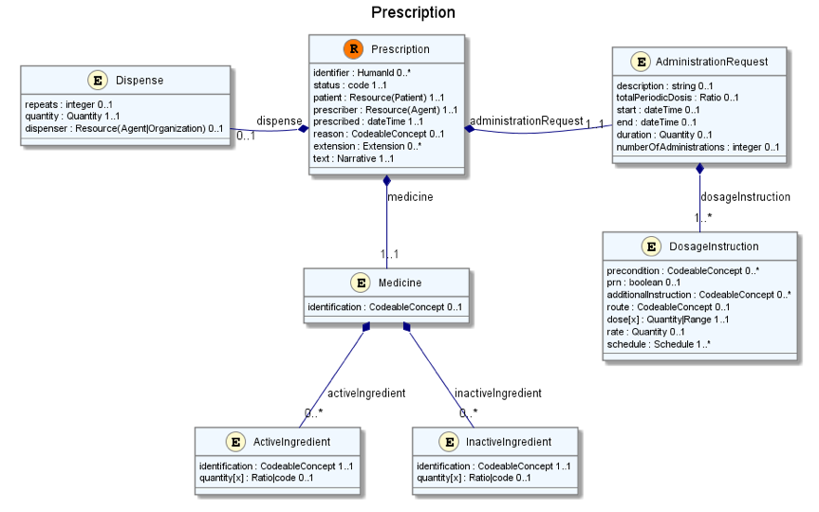

Slide 11
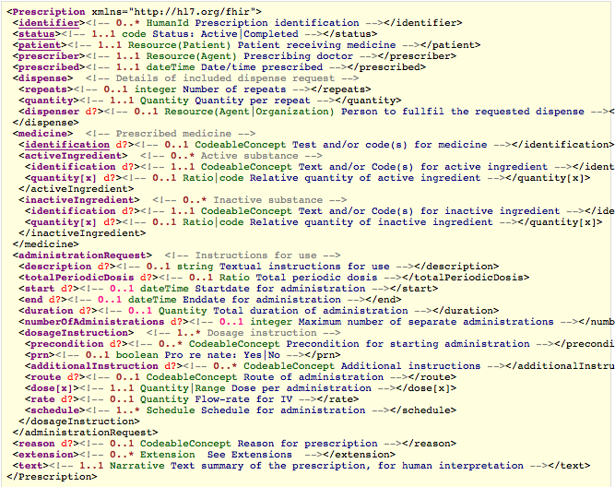

Slide 12
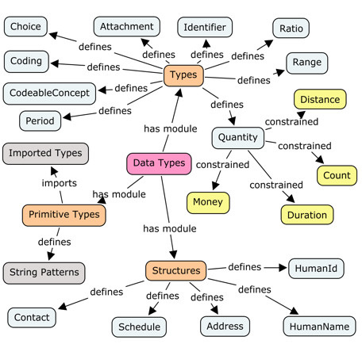
Datatypes
Notes:
What are datatypes
Where a re thy used
The image

Slide 13
Bundling
Combining multiple resource
Search results
Document
Message
XDS
uses Atom
Atom ‘wrapper’
Atom Header
Resource 1
Resource 2
Notes:
combining a collection of resources into a single XML document

Slide 14
Profiles
Another key concept
What ‘our jurisdiction’ needs to store in this resource / bundle
Defined by HL7, Country, Region, Project
Accessible on-line – via URL
Can be imported, re-used
Extensions
Extensions defined in profiles
Reference from resource (instance) to Profile (class)
Slicing
‘refining’ a resource (plus extensions)
Notes:
Purpose of profile
- extensions
- slicing

Slide 15
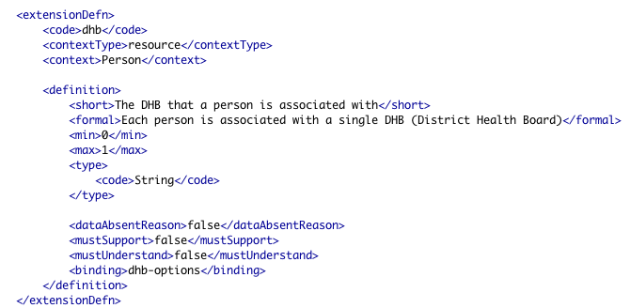
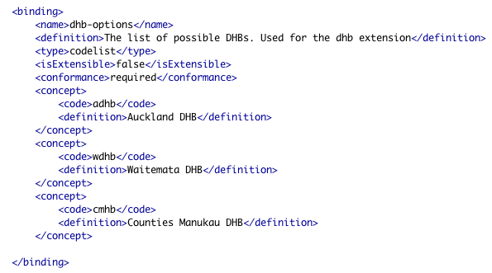
Profiles

Slide 16
REST

Slide 17
Definition of REST
REpresentational State Transfer
Roy Feilding
Precise usage can be controversial, but:
Use HTTP as transport
Concept of identified resources
Use HTTP verbs
GET - retrieve a resource
POST - create a new one
PUT - update an existing resource
DELETE - remove a resource
Use HTTP Headers (eg resource format)
Use HTTP status codes
Important: FHIR supports, but is not limited to, REST
Notes:
define what REST is
HTTP
verbs
URL’s,

Slide 18
Server Responsibilities
Manage Resources
Create, Read, Update, ‘Delete’
Search
Versioning
VRead
Root Bundle processing
XDS, Batch update
Conformance Statement
Notes:
Use of codes and terminologies
code, coding, codeableConcept
bindings to terminologies

Slide 19
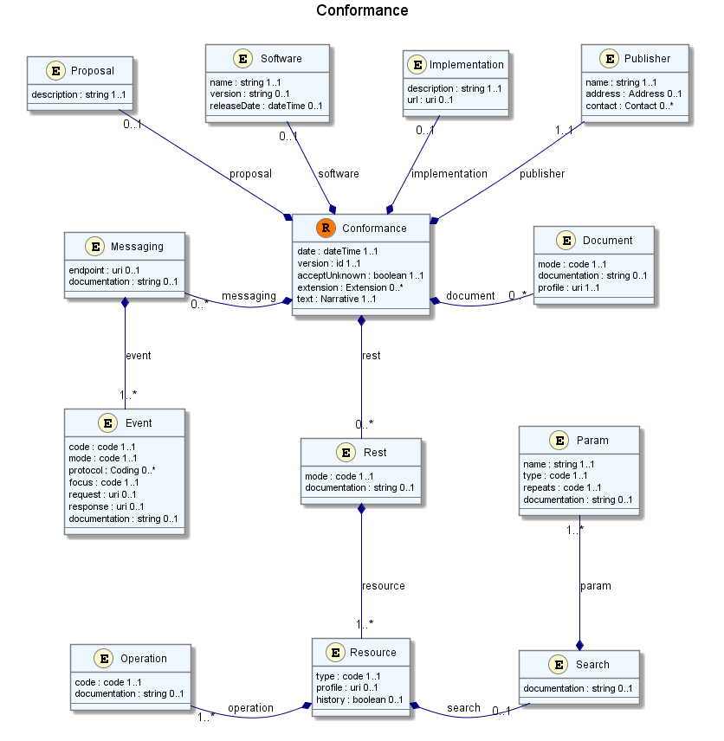
Conformance Stmt

Slide 20
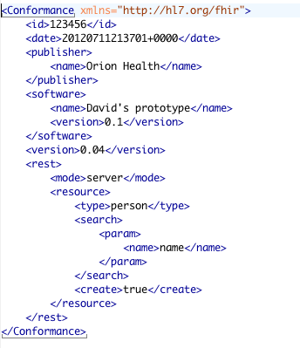
Conformance Stmt

Slide 21
DOCUMENTS
(Equivalent of CDA)
Notes:
purpose of document
relationship to CDA

Slide 22
FHIR Document
Atom
Document Header Resource
Resource 1
Resource 2
Document spec
A point in time collection of resources
Can be a ‘stand alone’ document (like CDA) or a aggregated resource type (often profiled)
‘child’ resources are like CDA sections

Slide 23
MESSAGE
(Analogous to v2)

Slide 24
FHIR Message
Atom
Message Header Resource
Resource 1
Resource 2
Document spec
Collection of resources sent as a result of some real-world event intended to accomplish a particular purpose
Event Codes & Definitions, like HL7 v2
V2 segments broadly map to resources
Includes a “Message” resource, similar in purpose to Message wrapper and MSH segment
May have associated behavior
Can be conveyed via MLLP, SOAP or other means

Slide 25
Service

Slide 26
SOAP Services
For more sophisticated requirements
security
business process
working with hData
Still use FHIR resources & packaging...
Example of Person & Contacts

Slide 27
XDS

Slide 28
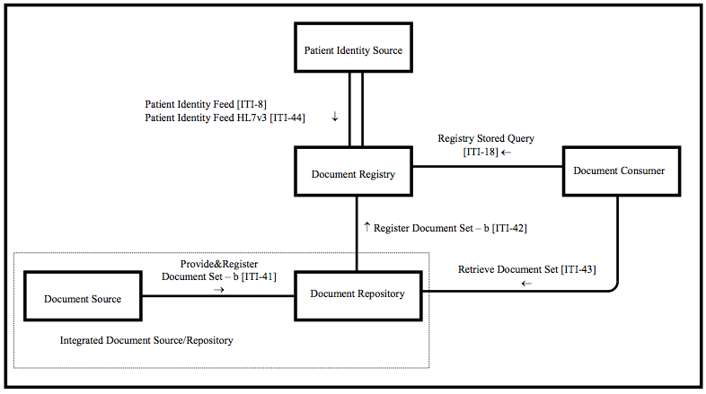
IHE XDS

Slide 29
XDS Affinity Domain
The users (regional / national / specialist)
Define what documents are stored and the meta data / processes
Eg
Security, Auditing, Access controls
Privacy mechanisms and levels
Folders
Document metadata
Format
Class
Type

Slide 30
FHIR XDS
a FHIR front end to XDS
work with MHD
simplify access to XDS Server
XDS XML is hard!
Others have taken this approach
This one will be standard
Working with IHE MHD (Mobile Health Data)

Slide 31
IHE XDS
FHIR services ‘in front’ of XDS calls
Could augment / replace in some cases

Slide 32
Submission Package
Atom ‘wrapper’
XdsEntry resource
Base64 encoded content
Standard FHIR Atom feed
Has 2 resources:
xdsEntry ‘Header’ (metadata)
Base64 content

Slide 33
Document retrieval
Plain content
Plain HTTP GET from Repository
Already have the metadata from the registry
(including the URL of course)
Most efficient method

Slide 34
Conclusion
FHIR is a very exciting new standard
We can expect selected ‘production/pilot’ deployments within a year
It would be great in NZ was one of them
Great international exposure!
References
List server : lists.hl7.org
Web site: www.hl7.org/fhir

Slide 35
Questions?

